Slide 1
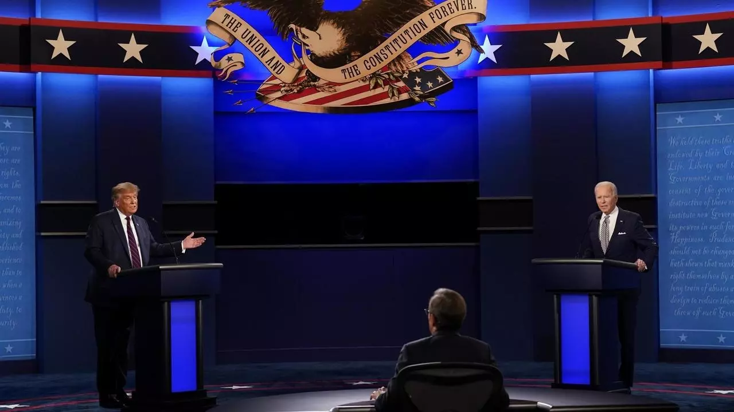

US ELection
Joe biden or donald trump

Slide 2
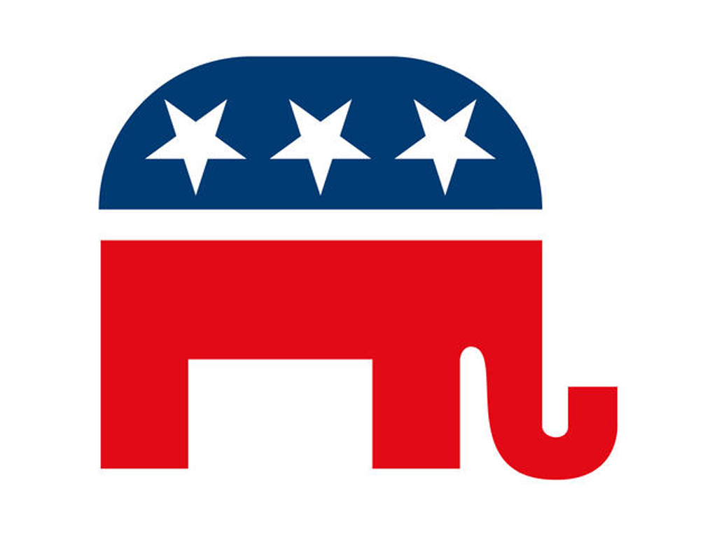
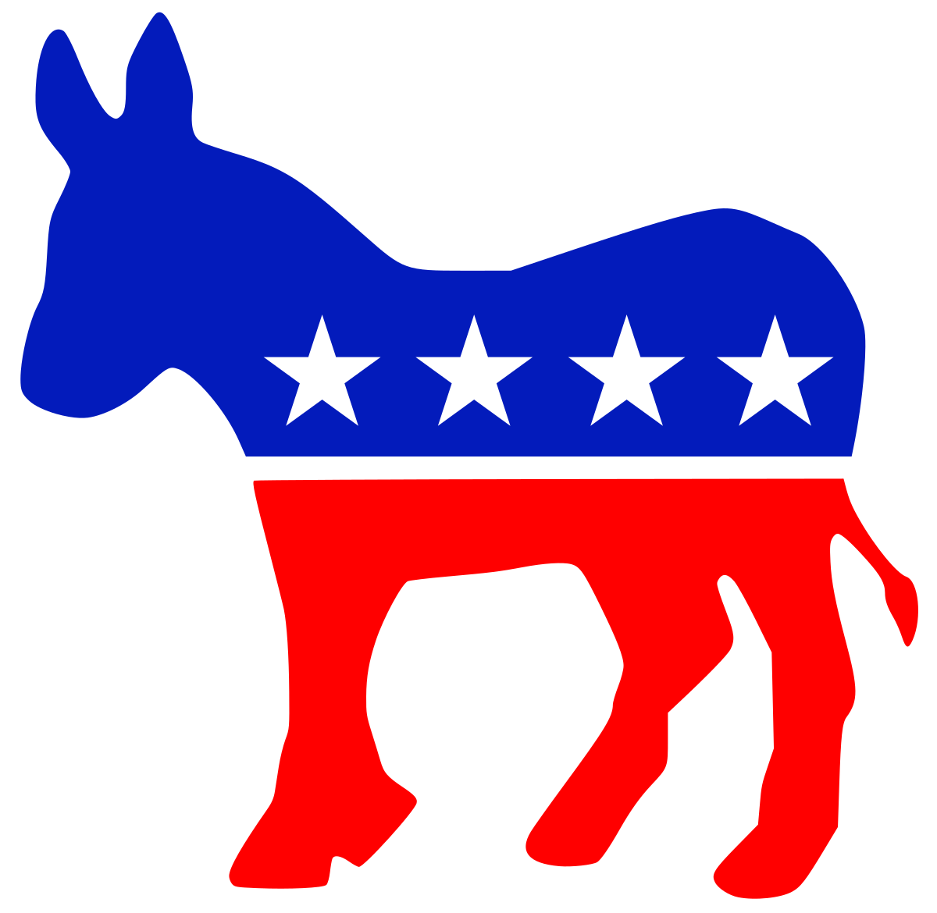
Primary season

Slide 3
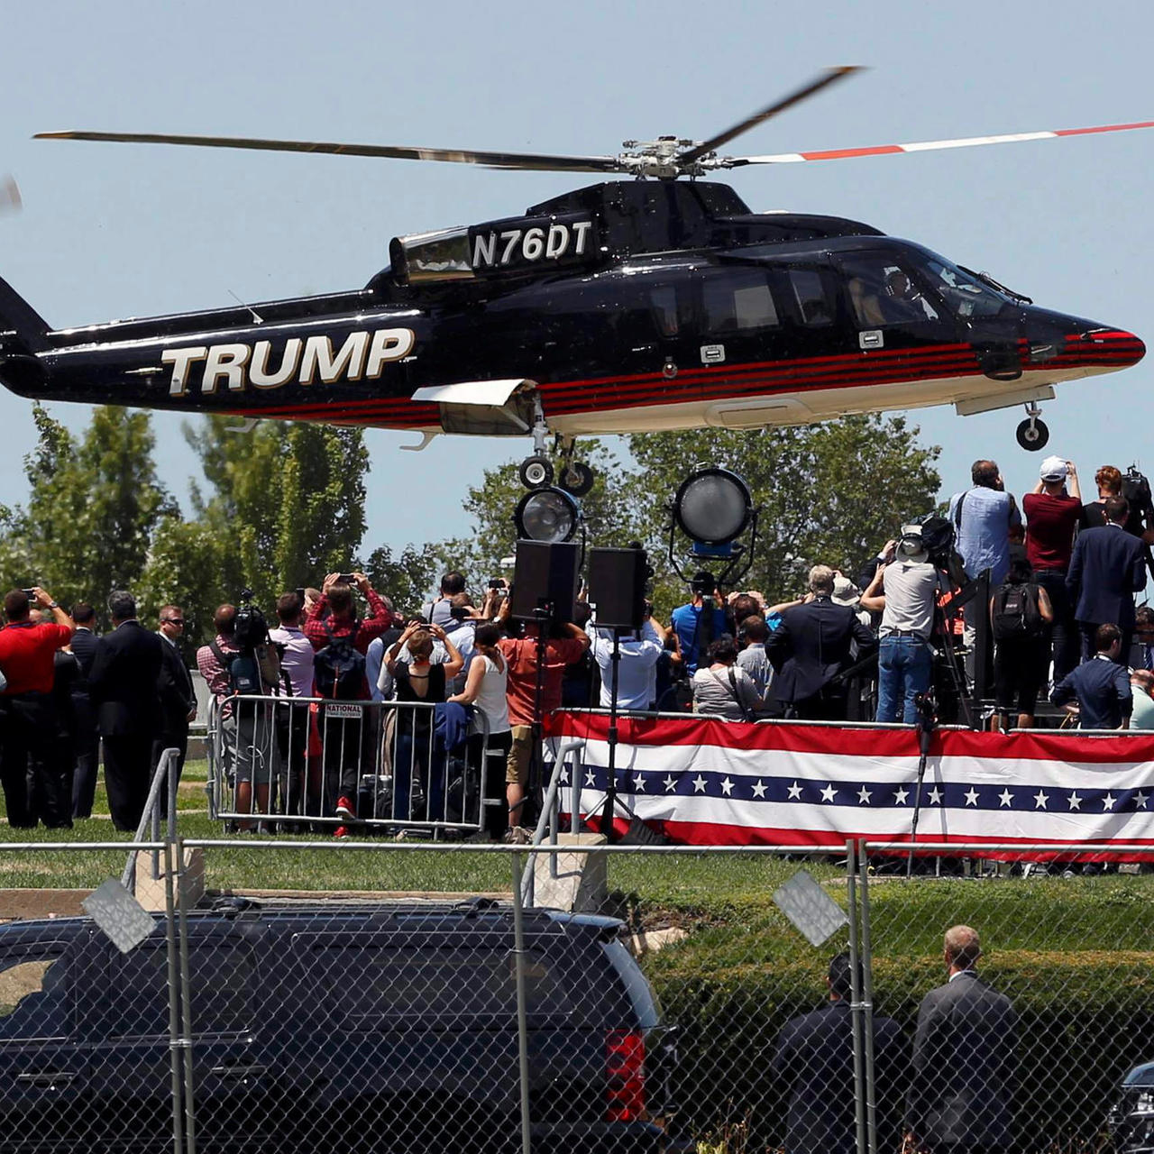

CAMPAIGN

Slide 4
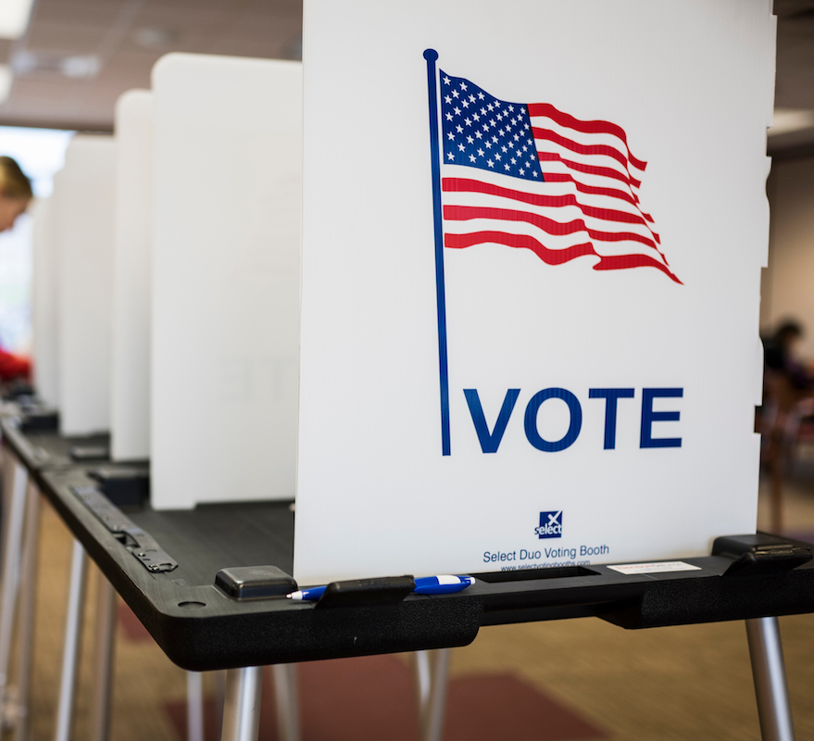

POPULAR VOTE

Slide 5
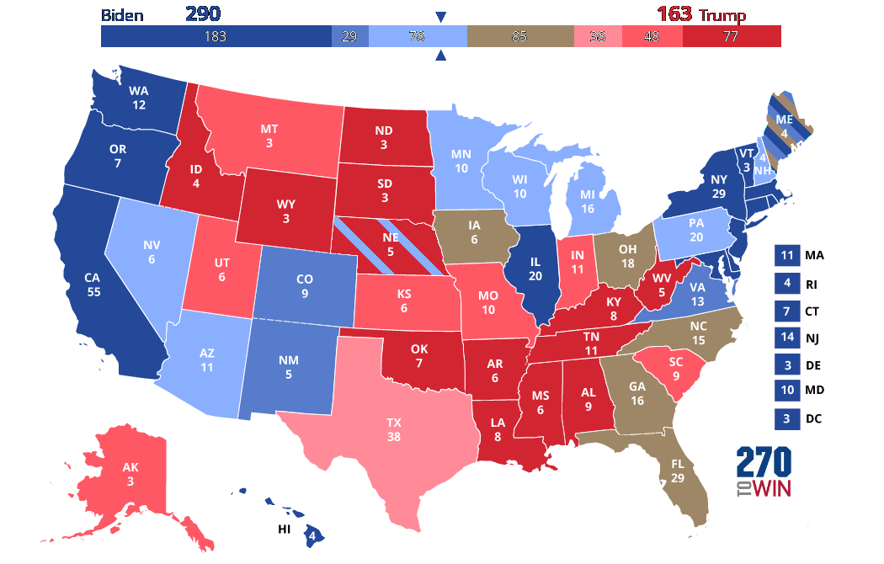
ELECTORAL COLLEGE

Slide 6
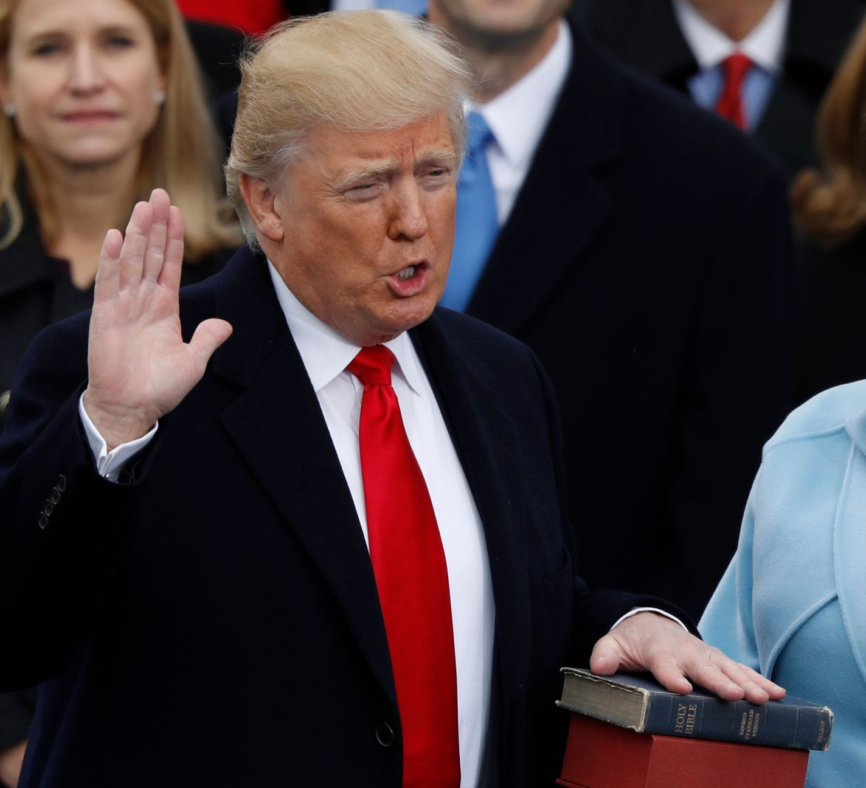
president TAKES OFFICE

Slide 7
Election timeline
Primary season started
February
1
Summer convention
August
2
Popular vote
November
3
Electoral College meet
December
4
President takes office
January
5

